Slide 1
Security Landmine - No Cyber Security Awareness Training in the Workplace
Jerry Wynne, CISA, CISSP, CIRSC
Vice President of Security, CISO

Slide 2
Disclaimer
This document and any oral presentation accompanying it are not intended/should not be taken as necessarily representing the policies, opinions, and/or views of Noridian Mutual Insurance Company, Blue Cross Blue Shield of North Dakota, Noridian Healthcare Solutions, any of their component services, or any other affiliated companies.
This document and any oral presentation accompanying it has been prepared in good faith. However, no express or implied warranty is given as to the accuracy or completeness of the information in this document or the accompanying presentation

Slide 3
Agenda
Current State of Security
Phishing Types
Most Users
Phishing Examples
Another Phishing Type
Who’s fault is this?
How do we fix this?

Slide 4
Who am I?
Currently employed by Noridian Mutual Insurance Company
DBA: Blue Cross Blue Shield of North Dakota an independent licensee of the Blue Cross Blue Shield Association
DBA: Noridian Healthcare Solutions
Assisting: Three other Healthcare plans with Security
Vice President of Security, Chief Information Security Officer (CISO)
Responsible for both Electronic and Physical Security
3200 employees, 15+ locations coast to coast
Staff of 70+, physical and electronic security professionals
Certifications include:
Certified Information Systems Auditor (CISA)
Certified Information System Security Professional (CISSP)
Certified in Risk and Information System Control (CRISC)
Over twenty years experience in Electronic Security, with over fifteen years of leadership in Electronic Security

Slide 5
Current State of Security

Slide 6
Current State of Security
Many Fileless techniques cannot be detected by “standard” security tools

Slide 7
Current State of Security
Security is getting more expensive and difficult to manage
Only a third of organizations believe they have adequate resources to manage security effectively. - Ponemon Institute

Slide 8
What are the risks?
For purposes of this presentation we will be focused on Phishing and users…

Slide 9
Phishing Types
Methods Include:
E-mails: via links within e-mail
Phone Calls
Websites: mimic legitimate business websites
Bank or credit card company
Online payment provider
Government organization
Asks you to update or validate information
Threatening or excited statements
Promises reward

Slide 10
Most Users
Humans continue to fall victim to social engineering attacks, the 2018 Verizon report found. Email continues to be the main entry point for malware, with 96% of attacks coming through use inboxes. Companies are also nearly three times more likely to get breached due to social attacks than actual vulnerabilities, the report found—highlighting the need for ongoing employee cyber education.

Slide 11
Most Users Attitude

Slide 12
Most Users…
According to PhishMe’s Enterprise Phishing Resiliency and Defense Report, phishing attempts have grown 65% in the last year
According to the Verizon Data Breach Investigations Report, 30% of phishing messages get opened by targeted users and 12% of those users click on the malicious attachment or link
According to the SANS Institute, 95% of all attacks on enterprise networks are the result of successful spear phishing

Slide 13
Real Attempt
Notes:
This is actually whaling a phishing attempt meant to target upper management.

Slide 14
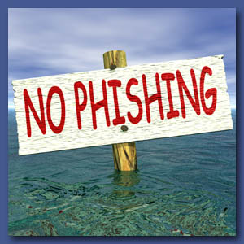
Phishing Awareness
Things to watch for:
Spelling and grammar errors
Threatening or excited statements: “Your account will be disabled”
Suspicious requests for information
Links to forms or other websites
DO NOT click on the link to “test” the email
Do not click on any links or open attachments
Report any suspected phishing activities
Forward the suspicious email
Delete the email
Notes:
Do you have your fish??? Should be on your desk. You can also find it on NT under quick links- titled report a suspicious email
Mail abuse button on your outlook ribbon

Slide 15
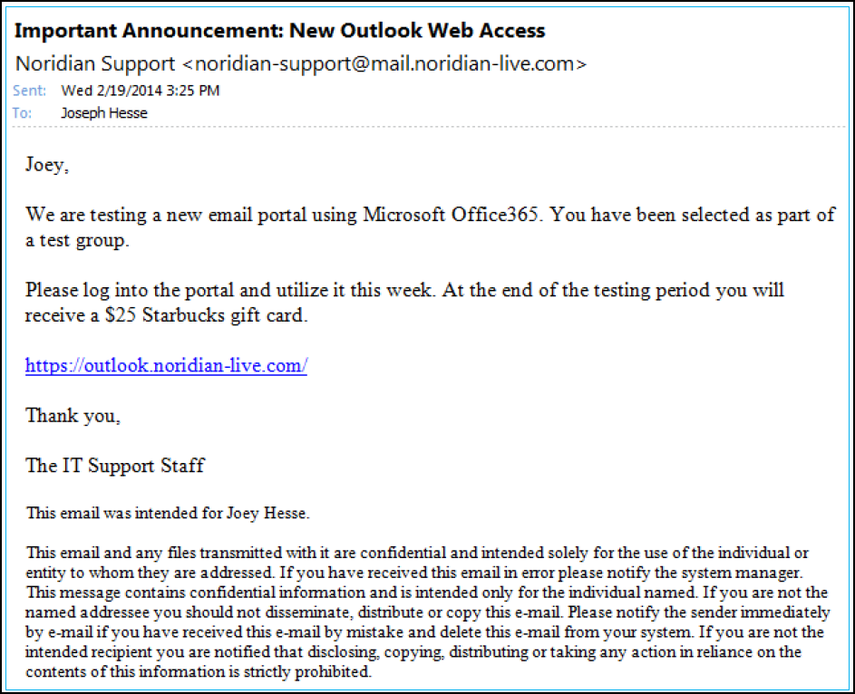
What to look for in a Suspicious Email
Suspicious Sender
Requesting information
Incorrect link
Suspicious team
Incorrect
confidential
notice
Notes:
Clicking on the link-Opens to websites that cause credintials

Slide 16
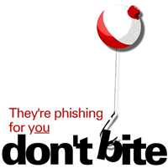
Don’t Click the Link
John Doe
Dear John Doe,
Notes:
This is an example of the phishing email from this year, this email was sent to random employees-we currently get tested once a year by a third party. This is an example of BCBSND they were also sent to Noridian and BCBSWY-39% of the employees clicked on the link compared to last years test which was 35%-Suspicious Sender-Requesting information-Incorrect Link-Suspicious team

Slide 17
Website Cloning
How long does it take for a hacker to create an exact duplicate of a commercial website and perform a spearfishing attack with tools available on the dark web?

Slide 18
More Users….

Slide 19
Another Phishing Pitfall
Ransomware!!!
Ransomware was the top variety of malicious software of 2017, found in 39% of malware-related data breaches. — Verizon, 2017
68% of data breaches took months or more to discover, though 87% had data compromised within minutes or less of the attack taking place— Verizon, 2017
Importantly, ransomware has started to impact business critical systems, rather than just desktops

Slide 20
Another Phishing Pitfall
Why ransomware?
Because that is where the money is at….
Credentials are being given away….
Current estimates state that approximately 45% of all companies hit with Ransomware attacks either pay the hackers or attempt to pay the hackers
This is a known revenue stream
But it is against the law…

Slide 21
Is Ransomware still an issue?
The percentage of malware payloads that were ransomware dropped from over 70% in June 2017 to less than 5% in December 2017
However, cryptomining malware booms
Cryptocurrency-mining malware provides a stealthier, more effective alternative to ransomware.
Why bother trying to extort victims when you can hijack their computers' CPU power to mine cryptocurrency directly, without them even being aware? That's the question more and more attackers have been asking themselves lately, and the majority have switched over to dropping cryptomining malware as a result.

Slide 22
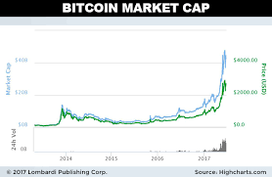
Why Crypto Currency?

Slide 23
Crash Course on Crypto Mining
What is a 'Blockchain'
A blockchain is a digitized, decentralized, public ledger of all cryptocurrency transactions. Constantly growing as ‘completed’ blocks (the most recent transactions) are recorded and added to it in chronological order, it allows market participants to keep track of digital currency transactions without central recordkeeping. Each node (a computer connected to the network) gets a copy of the blockchain, which is downloaded automatically.
Currently, the technology is primarily used to verify transactions, within digital currencies though it is possible to digitize, code and insert practically any document into the blockchain. Doing so creates an indelible record that cannot be changed; furthermore, the record’s authenticity can be verified by the entire community using the blockchain instead of a single centralized authority.

Slide 24
Crash Course on Crypto Mining
Blockchain Vs. Crypto Mining
Blockchain is “Constantly growing as ‘completed’ blocks (the most recent transactions) are recorded and added to it in chronological order, “
Crypto Mining is completing the blocks
For which the miner receives payment for their work
Cryptominers have impacted 55% of organizations globally. -Check Point

Slide 25
Is Cryptocurrency-mining malware illegal?
Depends
How was it installed?
Typically an inside job
Not everyone is being punished or placed in jail

Slide 26
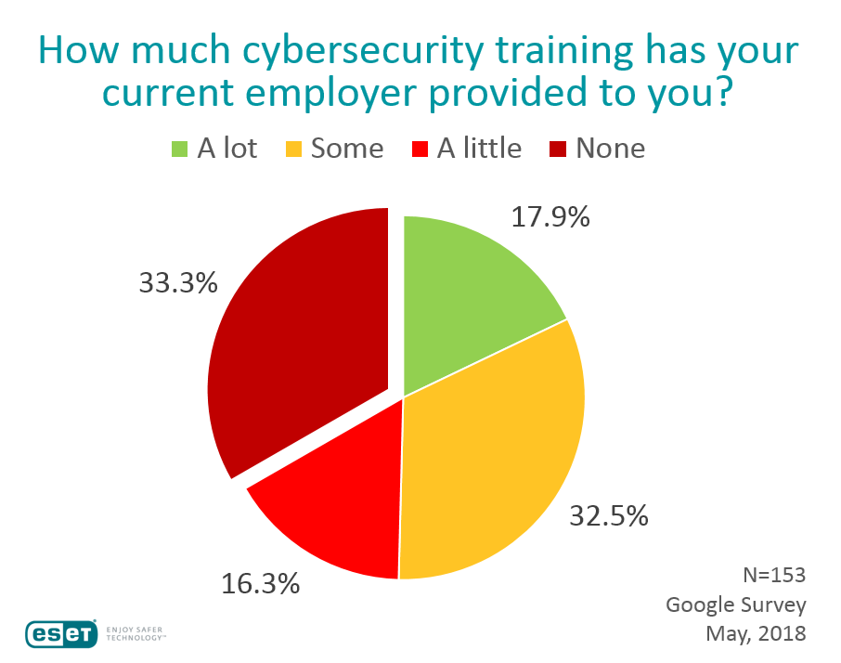
Who’s fault is this?

Slide 27
Who’s fault is this?
Most companies invest numerous hours in:
Benefit explanation
Job Overview
Culture discussions
Building Overview
But many companies neglect
Day one cyber security

Slide 28
To be clear….
This is a violation of HIPAA, PCI, and even state laws, like Massachusetts 201 Cmr 17.00: Standards for the Protection of Personal Information of Residents of the Commonwealth
But in many cases companies are not fined and the issue does not come up until they are sued

Slide 29
To be fair…
Employers assume that new hires will come to them with some level of security awareness and education (after all, as noted, it is 2018 already)

Slide 30
How do we fix this?
Cybersecurity education needs to be an integral part of the workplace culture
How?
Posters
Monthly Emails
Monthly Internal tests
Trinkets
Get creative

Slide 31
Cyber Security Education
Cyber Security Training for Employees. ... Security awareness training teaches employees to understand vulnerabilities and threats to business operations. Your employees need to be aware of their responsibilities and accountabilities when using a computer on a business network

Slide 32
Questions?
Jerry.a.Wynne@gmail.com

Slide 33
References
Slide 11 - https://www.techrepublic.com/article/only-26-of-us-companies-that-paid-ransomware-attackers-had-files-unlocked/
Slide 12 - https://www.welivesecurity.com/2018/05/21/cybersecurity-training-still-neglected/

